Slide 1
9 Genomics and Beyond
Brief Chapter Outline
I. Genetic, Cytological, and Physical Maps
II. Human Genome Project
A. Goals of the Human Genome Project
B. Public and Private First Drafts of the Human Genome Sequence
C. Comparative Genomics
D. Human Genome Project and Disease
III. Other Genome Projects
A. Mouse and Other Animals
B. Invertebrates
C. Plants
D. Microorganisms
IV. Functional Genomics
V. Proteome and Proteomics
VI. Other “-omes”
A. Biotech Revolution: Pharmacogenomics
VII. Bioinformatics
A. Databases
B. Tools of Bioinformatics
VIII. Cause for Concern? Ethical, Legal, and Social Implications

Slide 2
I. Introduction to Genomics.
A. Genomics is a scientific field involving the determination of the content, organization, and evolution of the genomes of different organisms.
B. Genomics is closely related to bioinformatics, which uses computers, computational tools, and databases to organize and analyze DNA and protein information.

Slide 3
Goals of genomics:
1. The assembly of physical and genetic maps of the genomes of different organisms.
2. The compilation and organization of both expressed gene sequences and other non- expressed regions.
3. The generation of gene expression (that is, transcription, or the production of transcripts) profiles under different conditions.
4. Finding the location of all genes in a genome and annotating each gene.
5. The determination of gene function and regulation (functional genomics).
6. The identification of all proteins in a genome and their functions, including the detection of protein–protein interactions (called “proteomics”).
7. The characterization of DNA polymorphisms within the genomes of a species.
8. The comparison of genes and proteins in the genome of one species with genomes of other species (called “comparative genomics”).
9. The implementation and management of databases and genome-based research tools accessed through the Internet.

Slide 4
Genetic, Cytological, and Physical Maps.
A. There are two major maps that determine gene location in a genome:
1. Genetic linkage maps determine the relative arrangement and approximate distances between markers on the chromosomes.
2. Physical maps determine the physical location on the chromosomes in base pairs, and the distance between genes or DNA fragments with unknown functions (Figure 9.1).
B. Maps have different levels of resolution, and the level of resolution depends on whether the piece of DNA to be studied is large or small.

Slide 5
C. Genetic Linkage Maps (Figure 9.2):
1. Show the order and distance between pairs of linked genes, which are genes located on the same chromosome.
2. Determine the arrangement of genes or markers with unknown functions on a
chromosome based on how often two genes on the same chromosome are to be involved in crossing over, which is the exchange of genetic information between pairs of chromosomes during prophase I of meiosis.
3. Two genes are measured and given distances in centimorgans (cM).
4. For example, if two genes were involved in crossing over 1% of the time, then the distance between the two genes would be one cM. One cM is about one million base pairs (one megabase).

Slide 6
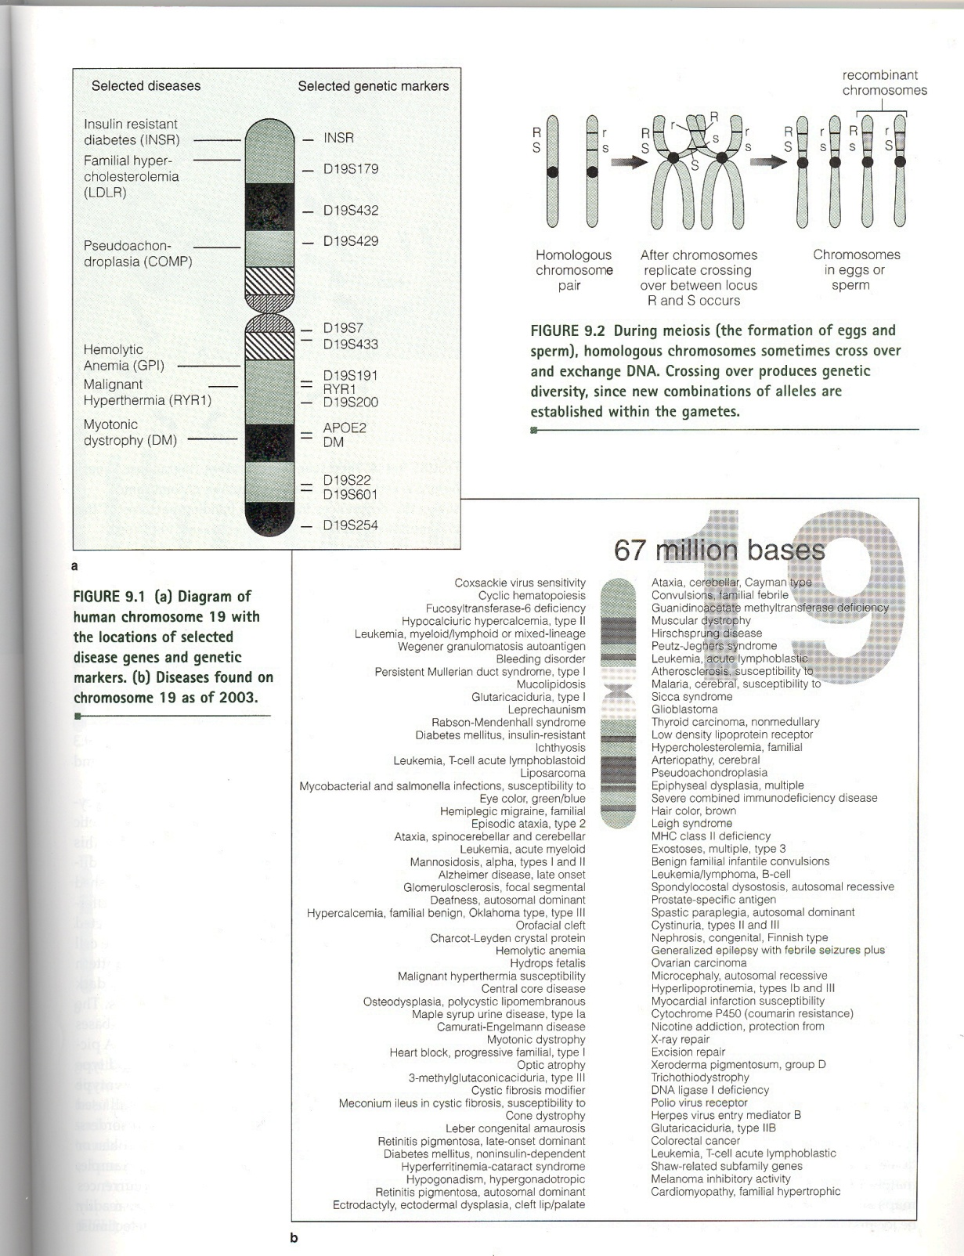

Slide 7
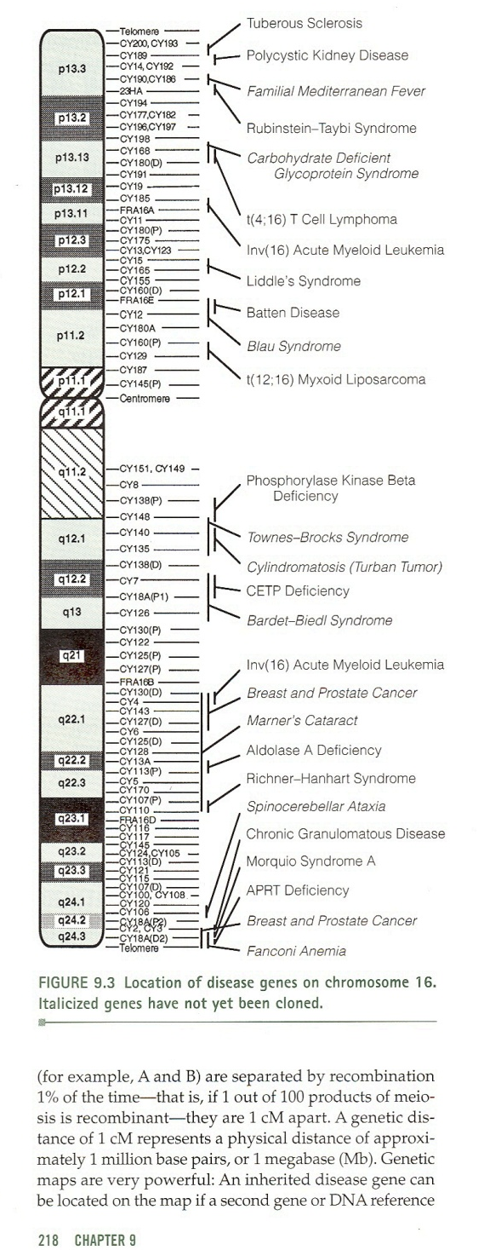

Slide 8


Slide 9
D. Cytological Maps.
1. Helps to align the genetic linkage map with the more specific physical map.
2. Involves the banding pattern of a chromosome through karyotyping, which is the staining of chromosomes and viewing them with a microscope (Figure 9.5).
3. Used to diagnose human genetic diseases caused by chromosomal abnormalities such as Down syndrome.
4. Fluorescence in situ hybridization (FISH) can also be used:
a) Metaphase chromosomes are spread out on a microscope slide.
b) A solution with a fluorescent-tagged DNA probe is added to the slide.
c) Probe attaches to the chromosome and is viewed with a fluorescence microscope (Figure 9.6).
d) Sometimes used to locate genetic markers associated with observable traits.

Slide 10
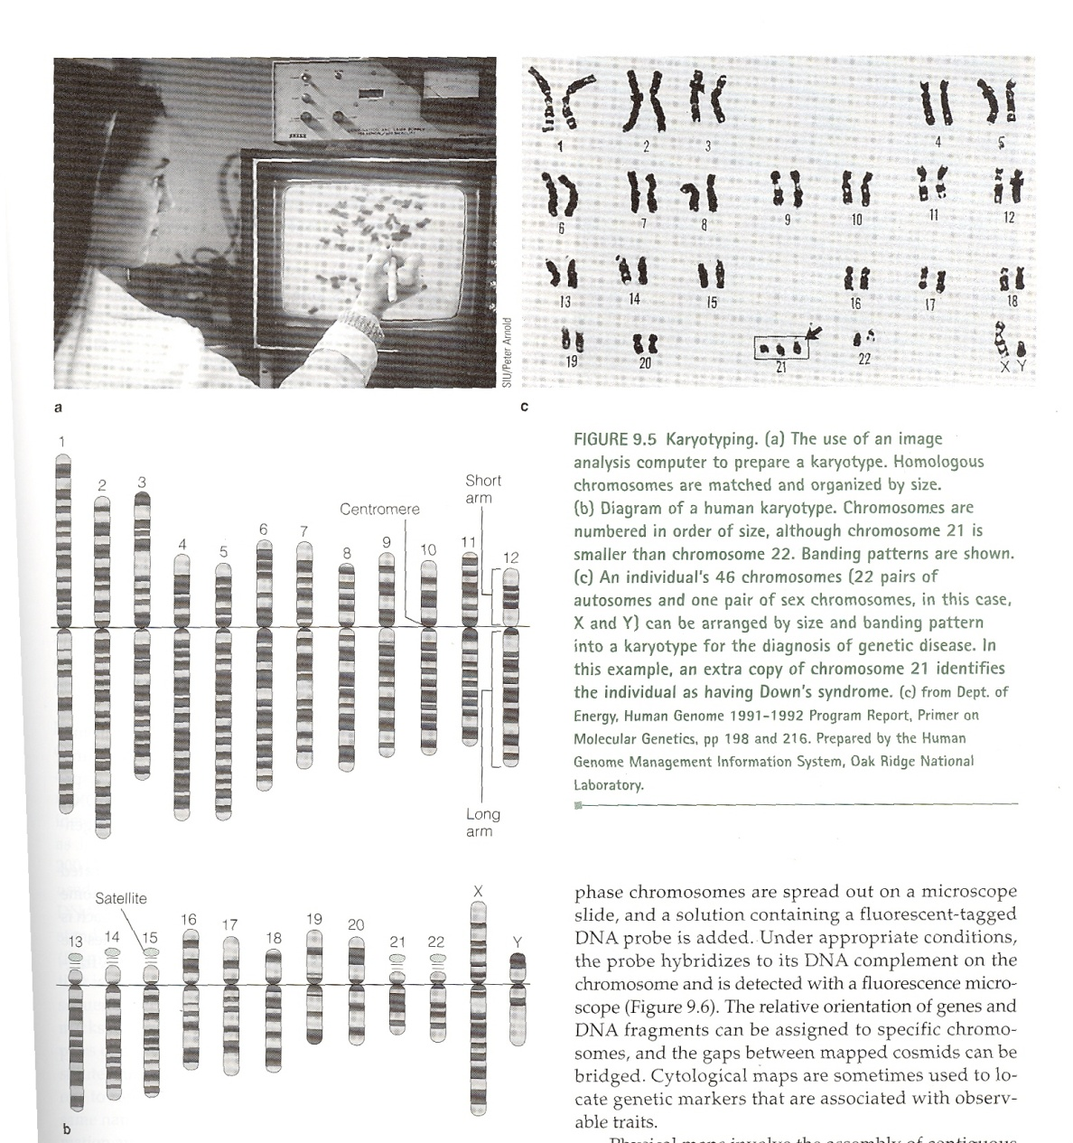

Slide 11
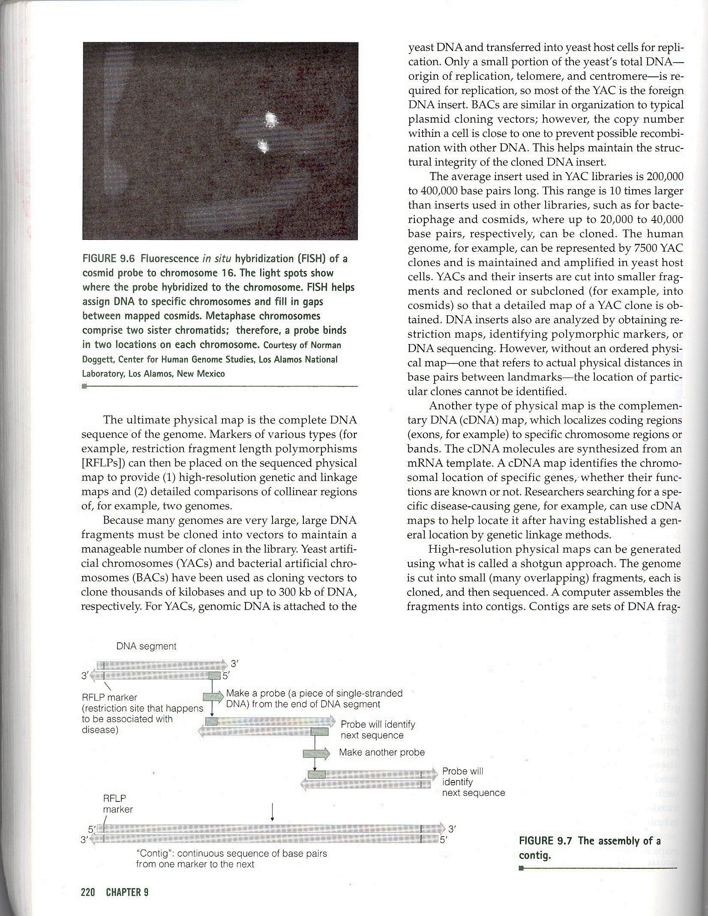

Slide 12
E. Physical Maps.
1. Involve the assembly of contiguous stretches of DNA, called “contigs,” where the distances between landmark DNA sequences are shown in kilobases (Figure 9.7).
2. Provide information about the physical organization of the piece of DNA, such as the location of restriction enzyme sites.
3. The ultimate physical map is the complete DNA sequence of the human genome, which is about 3 billion base pairs in length.
4. Because many genomes are large, the DNA has to be cut into fragments and cloned:
a) Yeast artificial chromosomes (YACs) can be used to clone pieces of between 300,000 and 400,000 base pairs long.
b) Bacterial artificial chromosomes (BACs) can be used to clone pieces of DNA of up to 200,000 base pairs in length.
5. cDNA maps can also be generated:
a) Localizes coding regions to specific chromosome regions or bands.
b) Identifies the chromosomal location of specific genes regardless of function.

Slide 13
6. “Shotgun” approaches can be used to generate high-resolution physical maps:
a) Contig maps take several steps to generate:
(1) Genome is cut into small, overlapping fragments with a restriction enzyme, and each piece is cloned, forming a DNA library.
(2) The DNA fragments must overlap other fragments, so the restriction enzyme is not allowed to cut at every possible restriction site.
(3) Computers assemble the fragments into contigs by determining which DNA
pieces have bands that are common.
(4) Unique regions of DNA can also be used to identify contigs, called “sequence- tagged sites” (STSs), which are used as probes.

Slide 15
7. Sequence-tagged sites (Figure 9.8):
a) Isolated from a chromosome-specific clone library or a clone within a contig.
b) A small region 200–400 base pairs long is sequenced and compared with all known
repeated sequences.
c) Unique sequences are identified by computer analysis.
d) PCR can also be used to identify, with unique STSs showing one band in gel electrophoresis.
e) Clones that share an STS are parts of the same contig.
f) Can be used as hybridization probes to fill in gaps or to identify an adjacent contig.

Slide 16
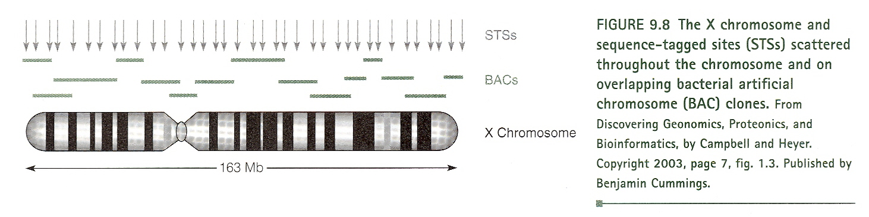

Slide 17
8. Sometimes gaps need to be filled in even after physical maps are made:
a) Microdissection (Figure 9.9) can cut a piece of DNA from a specific region of the chromosome. The piece can be cut by restriction enzymes and analyzed.
b) Chromosome walking uses a short DNA sequence at the end of a clone to search for an adjacent clone. Done until the end of a chromosome is reached.
9. Chromosome-specific libraries can be made so each chromosome has a contigmap, but need to separate each chromosome from others before mapping:
a) 24 libraries were needed for the human genome (22 autosomes and the two sex chromosomes).
b) Flow cytometry is an effective way to sort chromosomes:
(1) Chromosomes are dyed with two fluorescent dyes, one dye attaches to DNA rich in adenine and thymine, and the other attaches to DNA rich in guanine and cytosine.
(2) Chromosomes pass through a machine called a “flow cytometer,” which shines two laser beams on the chromosomes.
(3) Computer analyzes the fluorescence of both dyes, and sorts the chromosomes based on the fluorescence information.

Slide 18
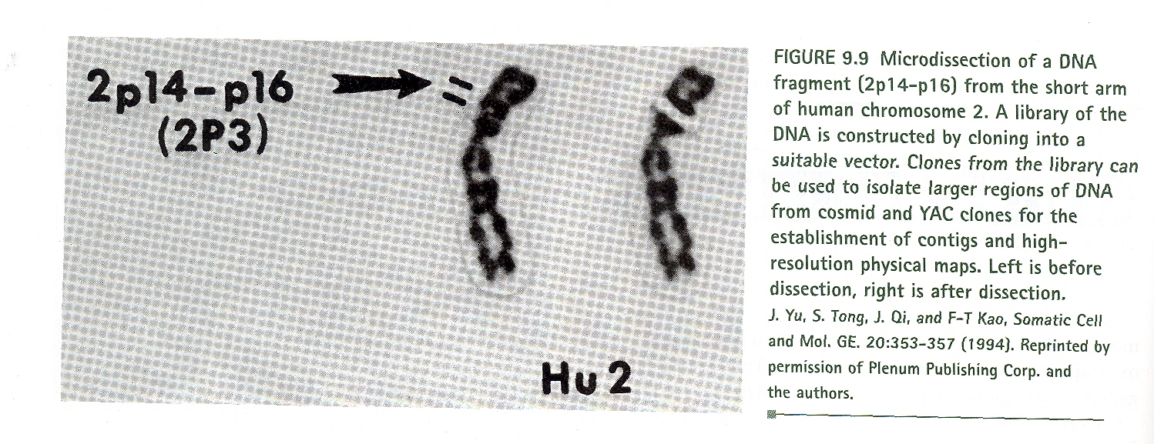

Slide 19
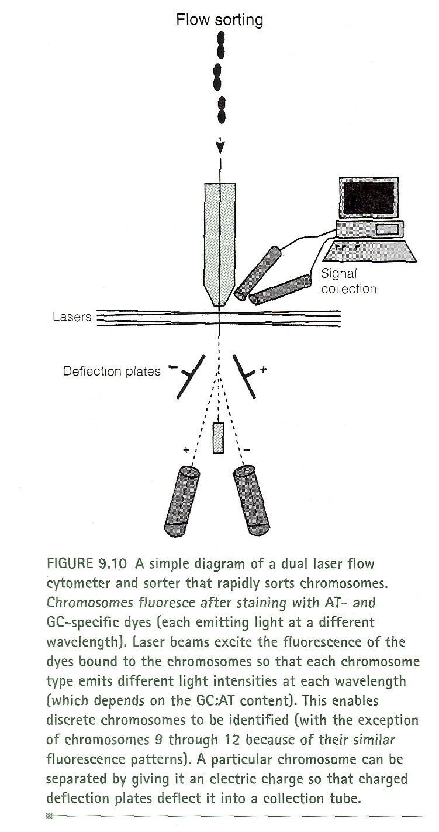

Slide 20
10. Resolutions of maps:
a) Lowest is the genetic map.
b) Restriction map is higher, mapping fragments of one to two megabases.
c) YAC clones are next, placing in order 400,000–1,000,000 base pair pieces.
d) Pieces generated by YAC clones are cut by restriction enzymes to create contig maps.
e) The highest resolution is the actual DNA sequence.

